Slide 1
Uber Fare Prediction
Made by :Menna Khaled

Slide 2
Introduction
Overview:
This project focuses on predicting Uber fare amounts using a rich dataset of ride information. The dataset contains 500,000 records and 26 features, capturing everything from ride metadata (e.g., pickup and dropoff coordinates, time of day, passenger count) to environmental factors (e.g., weather, traffic conditions, and distance to major landmarks). By analyzing these variables, we aim to uncover the main drivers of fare pricing, such as how distance, time, or weather might influence trip cost.
Purpose:
Exploratory Analysis: Understand patterns in how different factors—such as time of day, weather, or traffic—impact fare amounts.
Predictive Modeling: Build a robust machine learning model that can accurately estimate the cost of a ride before it completes.
Operational Insights: Provide actionable findings that can improve user experience (through transparent pricing) and operational planning (through better resource allocation).

Slide 3
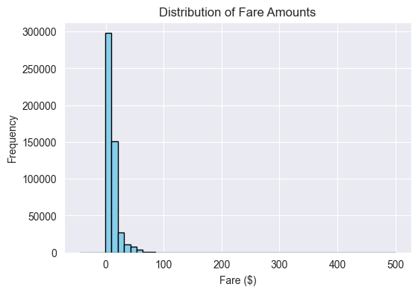
Q1: What is the overall distribution of fare amounts?
Answer: Most fares range from about $5 to $20, with a long right tail beyond $100.

Slide 4
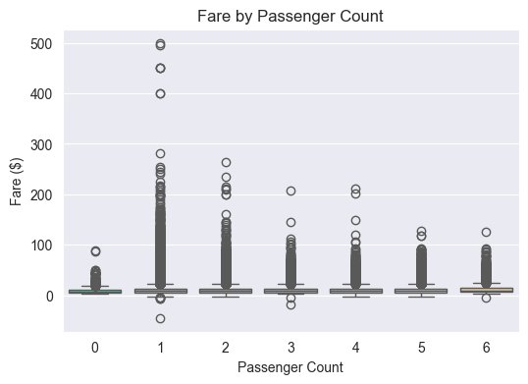
Q2: How does passenger count affect fare_amount?
Answer: Fares remain fairly stable across passenger counts, with a slight uptick for large groups.

Slide 5
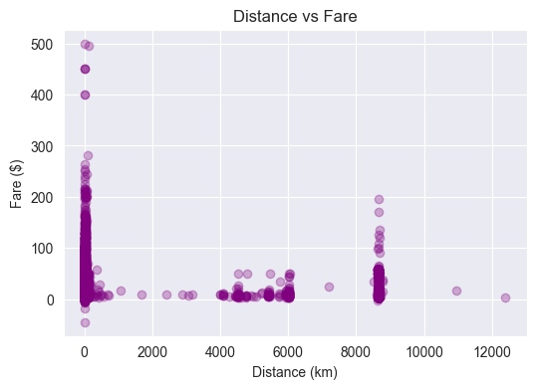
Q3: How strongly is distance correlated with fare_amount?
Answer: Distance shows a strong positive correlation with fare_amount..

Slide 6
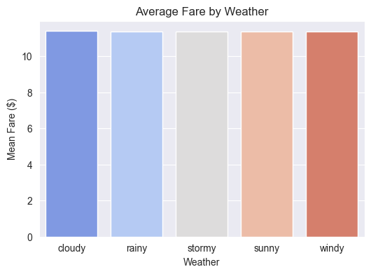
Q4: Does weather significantly influence fares?
Answer: No there is any Effects .

Slide 7
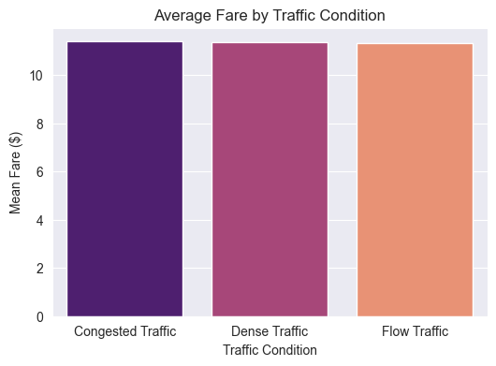
Q5: How do traffic conditions impact the fare?
Answer: The fare doesn’t affected

Slide 8
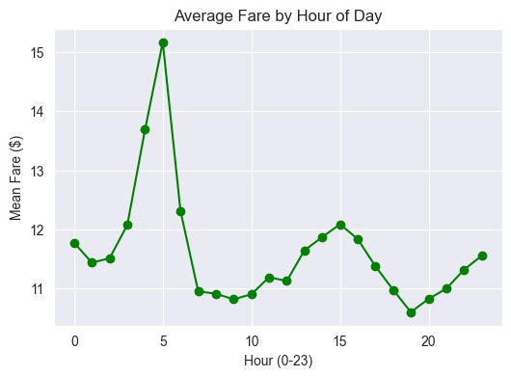
Q6: How does fare_amount vary by hour of the day?
Answer: Fares peak during typical rush hours (2-7 pm) and around late-night (12-3 AM).

Slide 9
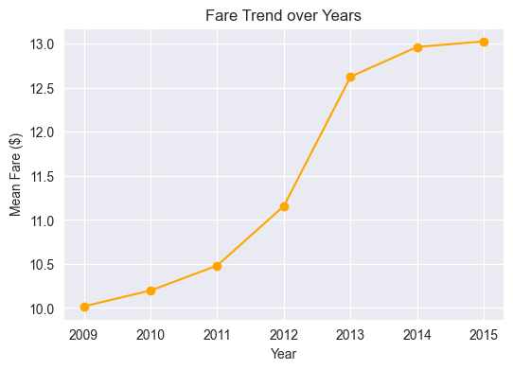
Q7: What is the trend in fare_amount over the years?
Answer: Fares increase each year from 2012 to 2015.

Slide 10
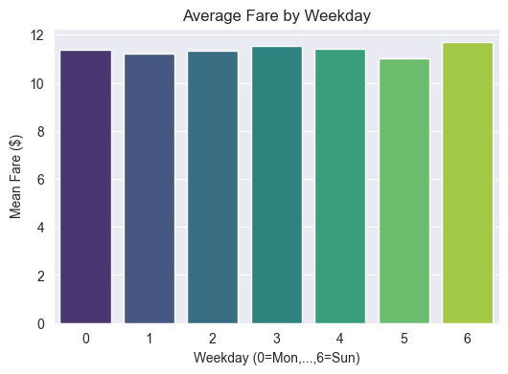
Q8: How do fares differ by day of the week?
Answer: Weekend fares (Thursday, Sunday) are Less than mid-week days.

Slide 11
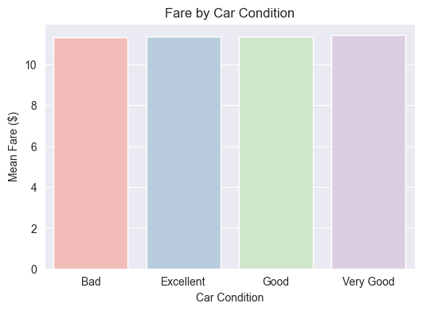
Q9: How does Car Condition correlate with fare_amount?
Answer: We see that the car condition not affect

Slide 12
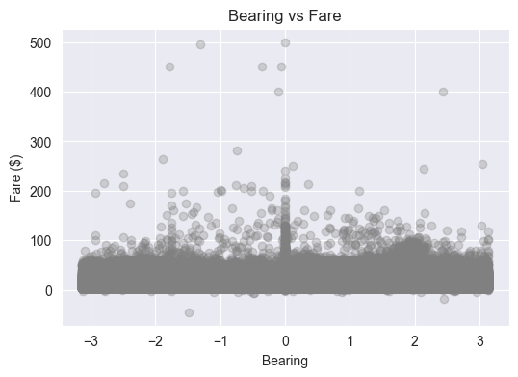
Q10: Does the bearing (trip direction) affect fares?
Answer: Slightly correlation found between bearing and fare_amount.

Slide 13
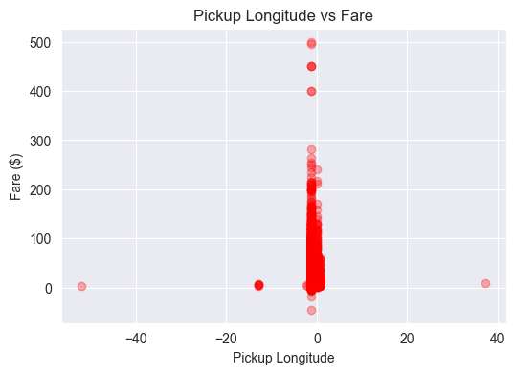
Q11: How do pickup and dropoff coordinates influence fare_amount?
Answer: Trips near city centers have more frequent short rides, while airport-bound rides can be higher fare.

Slide 14
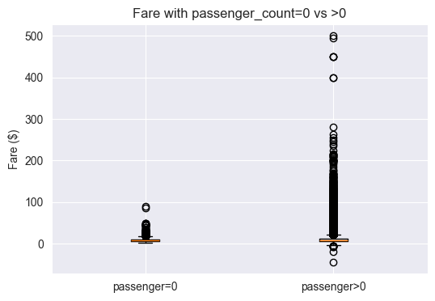
Q12: Does passenger_count ever reach zero? If so, how does it affect fare?
Answer: Zero passenger_count is small, potentially a data entry error. Fares with zero passenger_count are outliers.

Slide 15
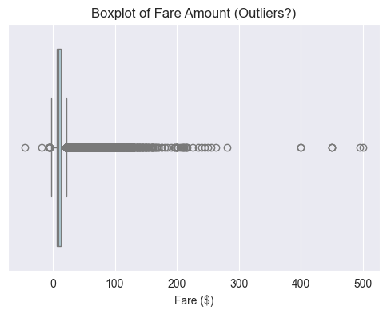
Q13: Are there significant outliers in the data?
Answer: Yes, a few extremely high fares above $200. They form a very small fraction of total trips.

Slide 16
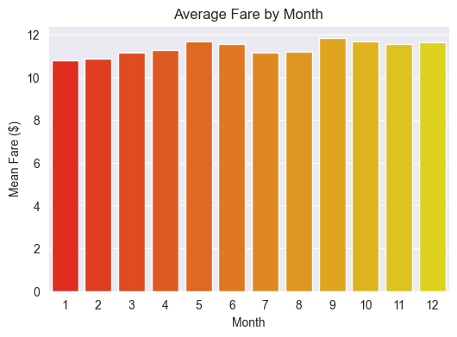
Q14: What about time-based features like day, month, and year combined?
Answer: Fares peak in certain months and certain days,Combining these features can capture seasonal demand patterns in your predictions.

Slide 17
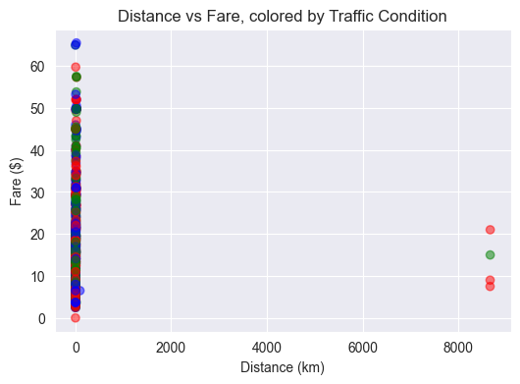
Q15: Which single feature stands out as most important for the model?
Answer: Distance stands out as the top predictor.

